Slide 1
LIST OF ARTIFICIAL INTELLIGENCE TOOLS

Slide 2
ARTIFICIAL INTELLIGENCE VIDEO GENERATORS AND EDITORS

Slide 3
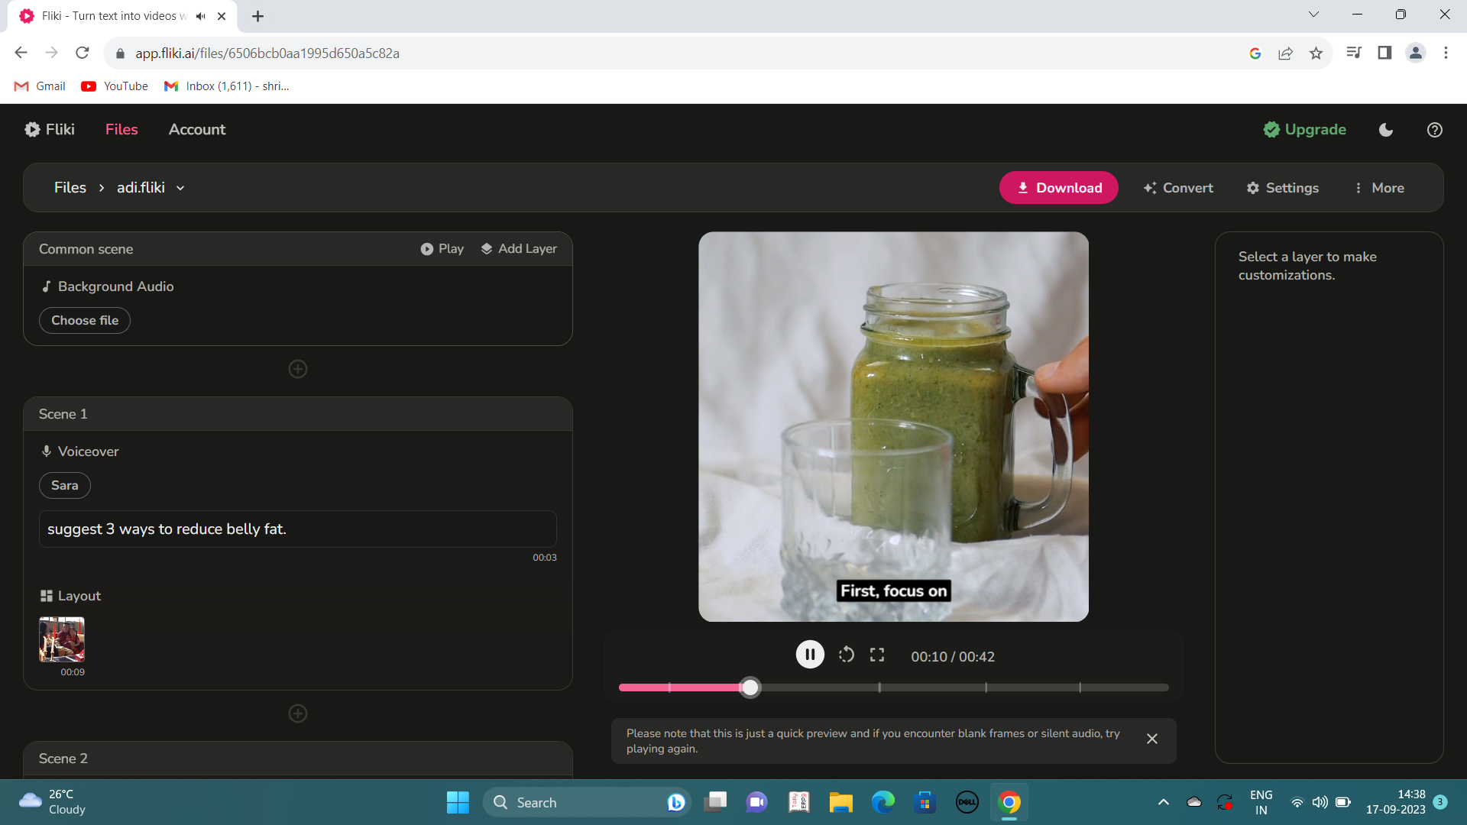
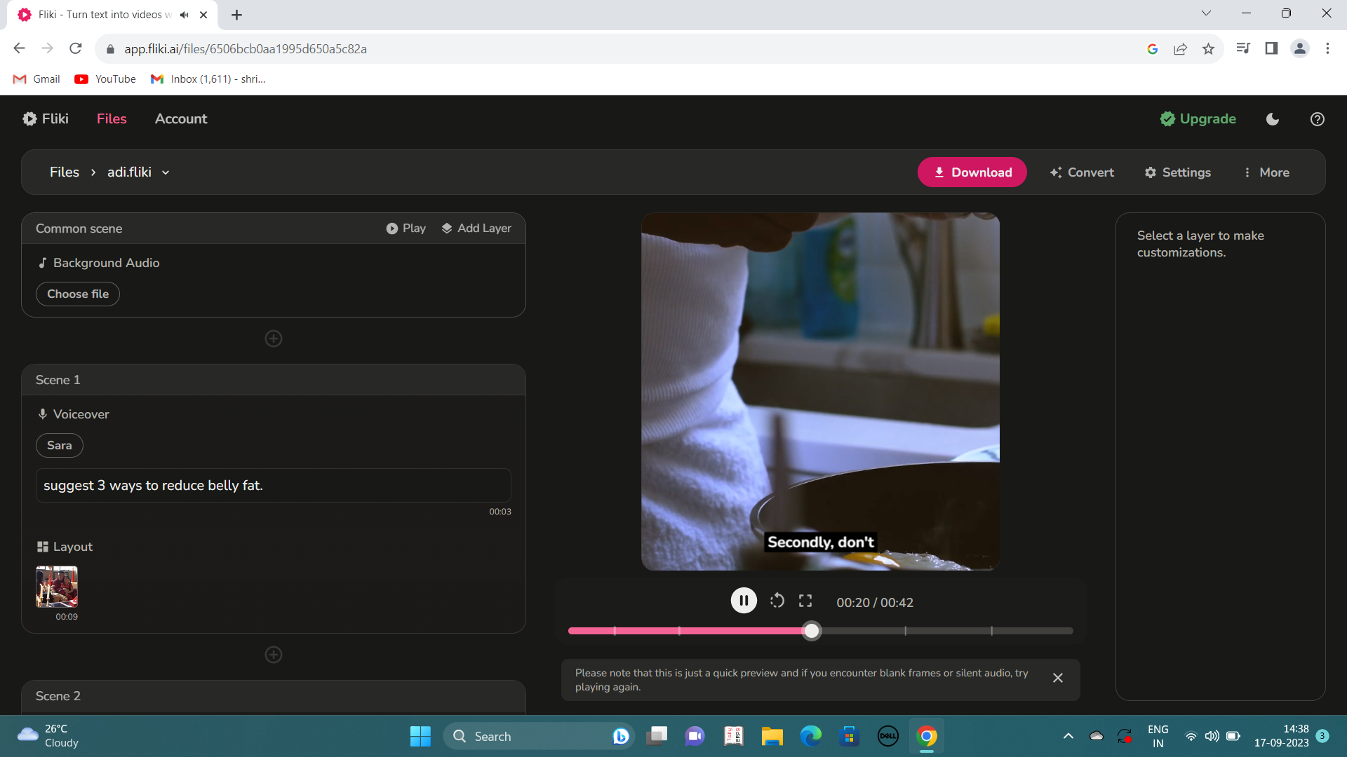
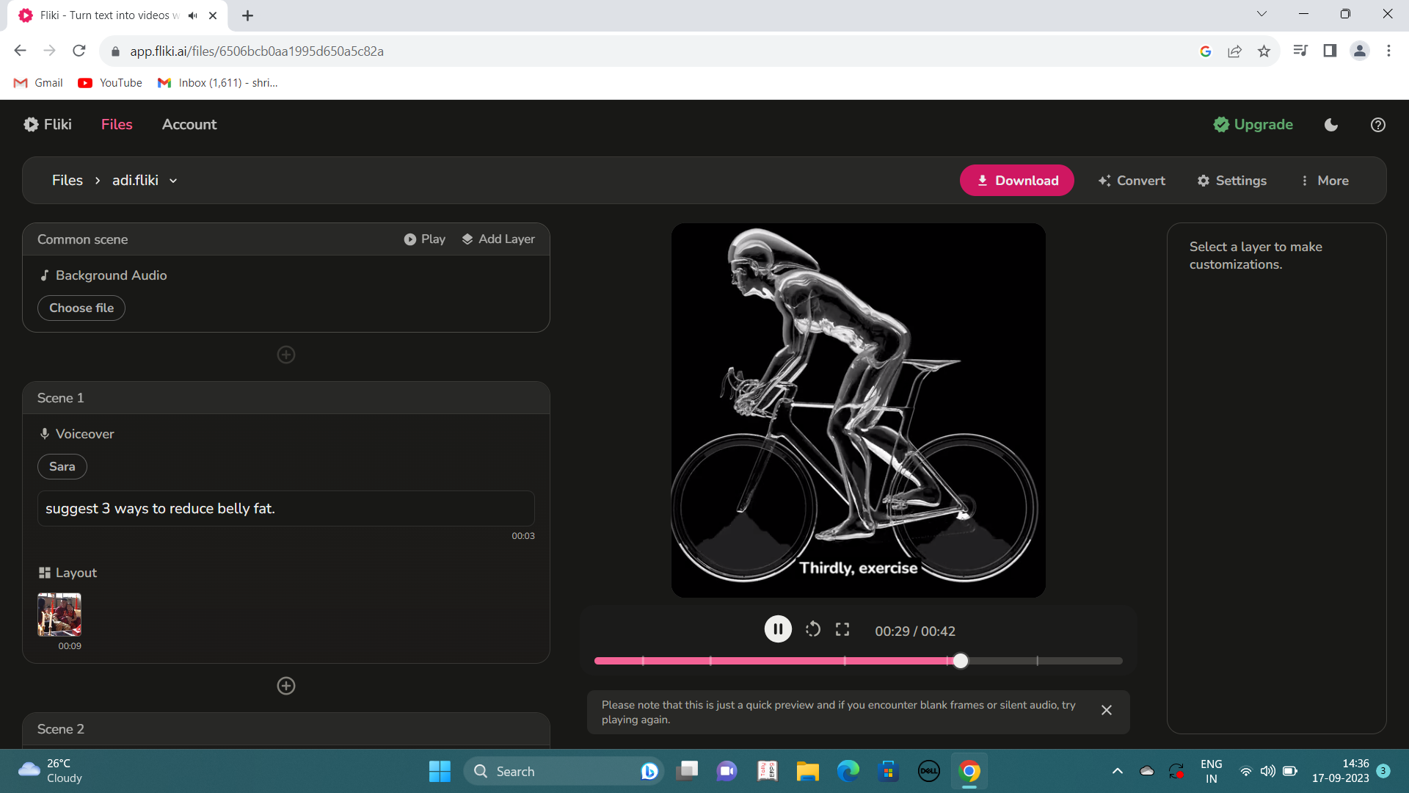
FLIKI
Fliki is an text to video and text to speech creator that helps you create quality audio and video content in minutes.
INPUT
Suggest 3 ways to reduce belly fat.
OUTPUT

Slide 4
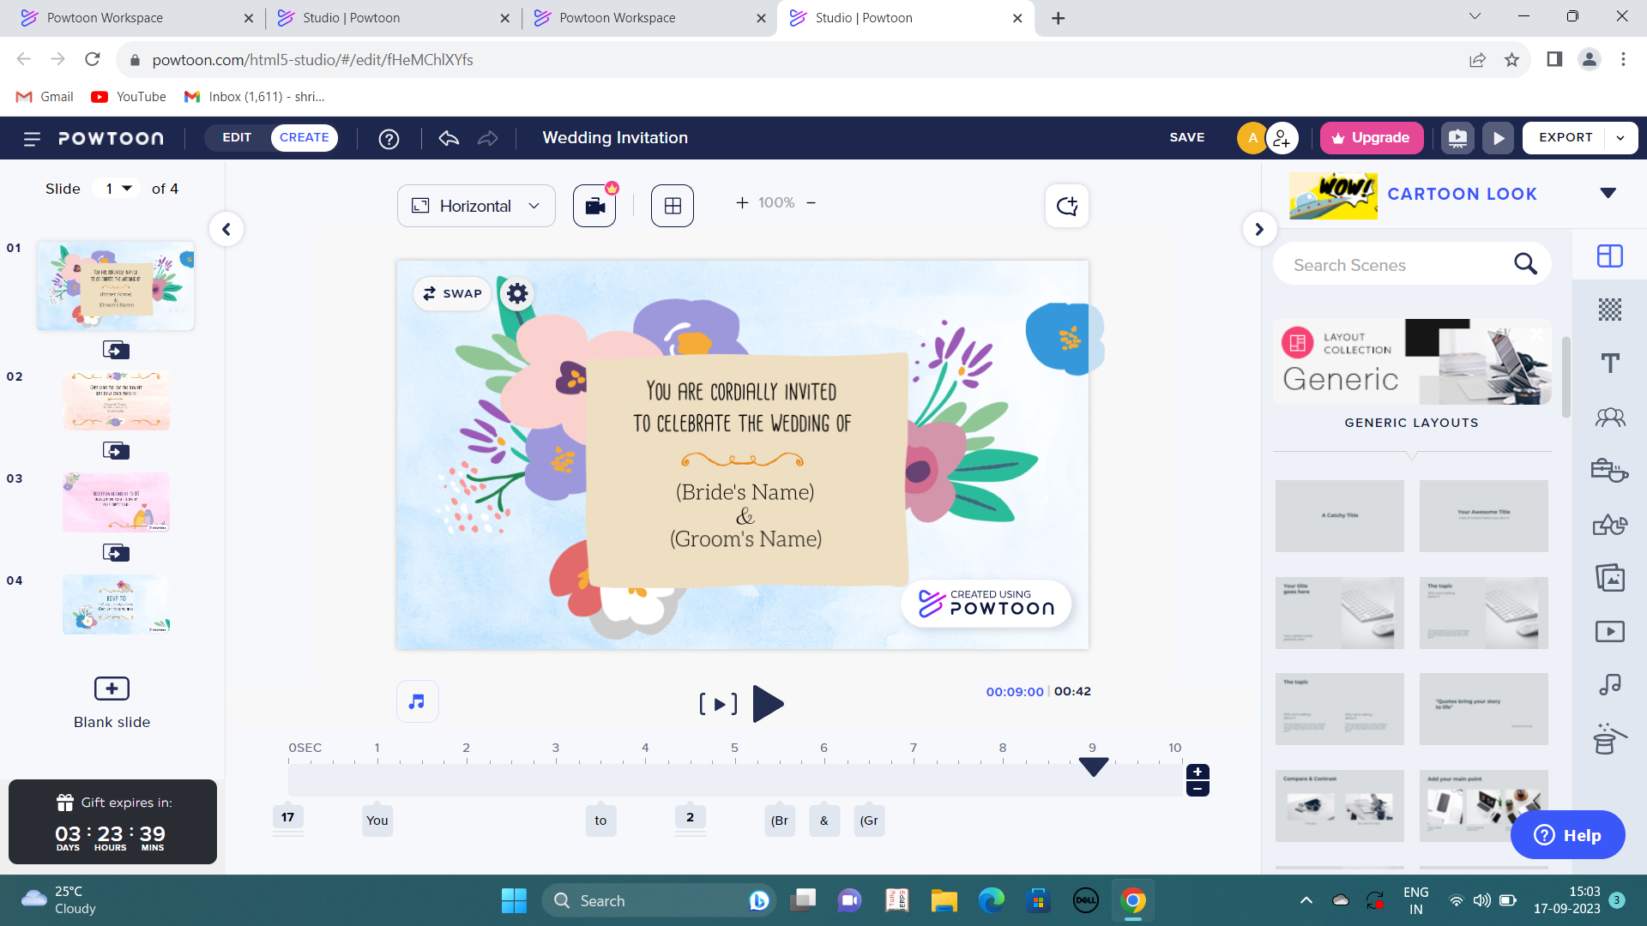
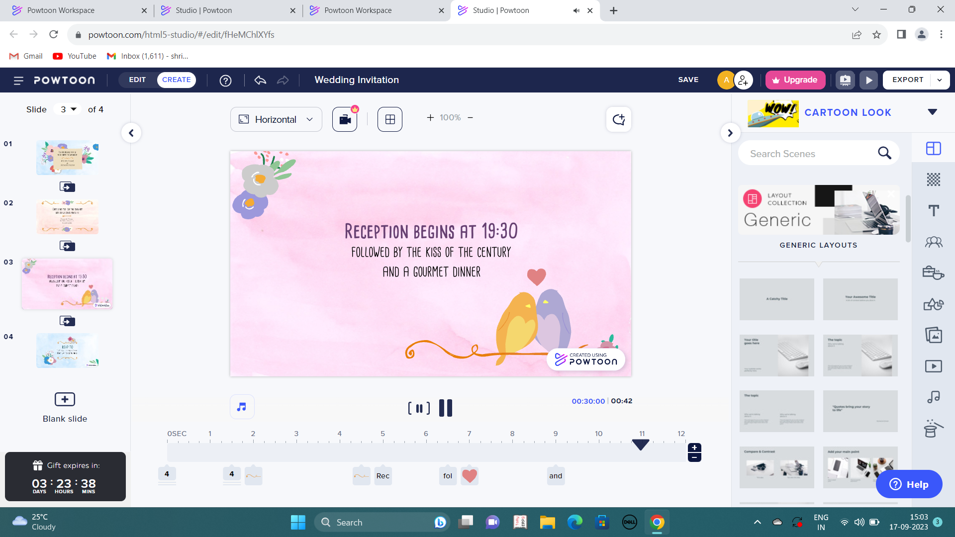
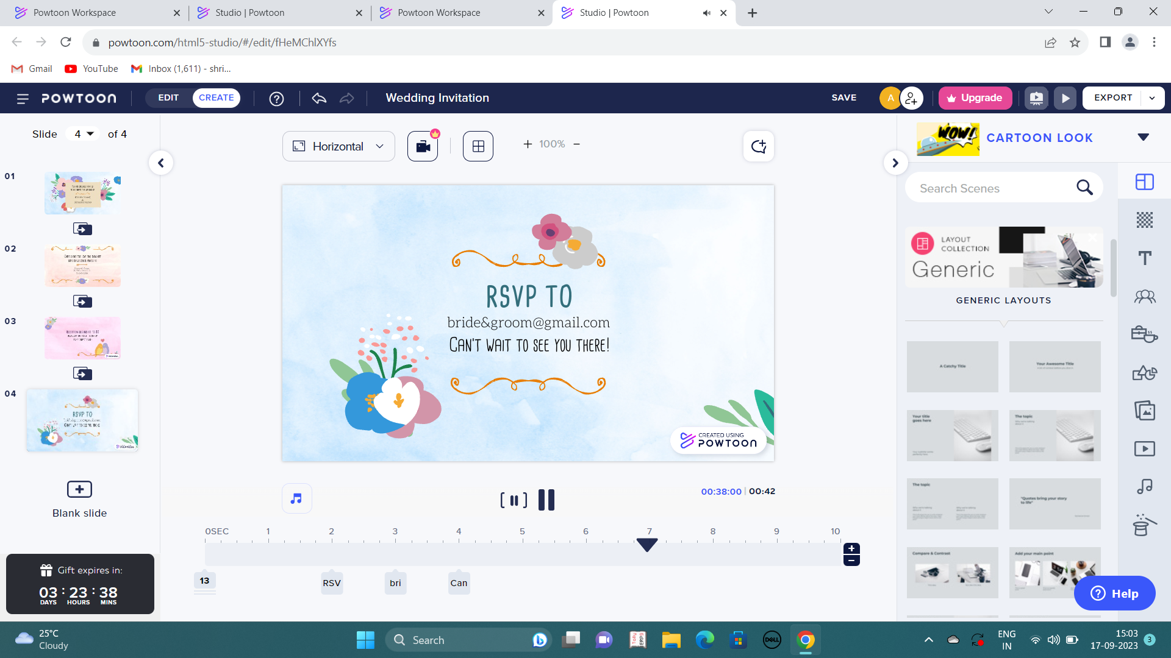
powtooN
Powtoon is a web-based animation software that allows users to create animated presentations by manipulating pre-created objects, imported images, provided music and user-created voice-overs.
INPUT
Wedding invitation.
OUTPUT

Slide 5
ARTIFICIAL INTELLIGENCE IMAGE AND ART GENERATORS AND EDITORS

Slide 6
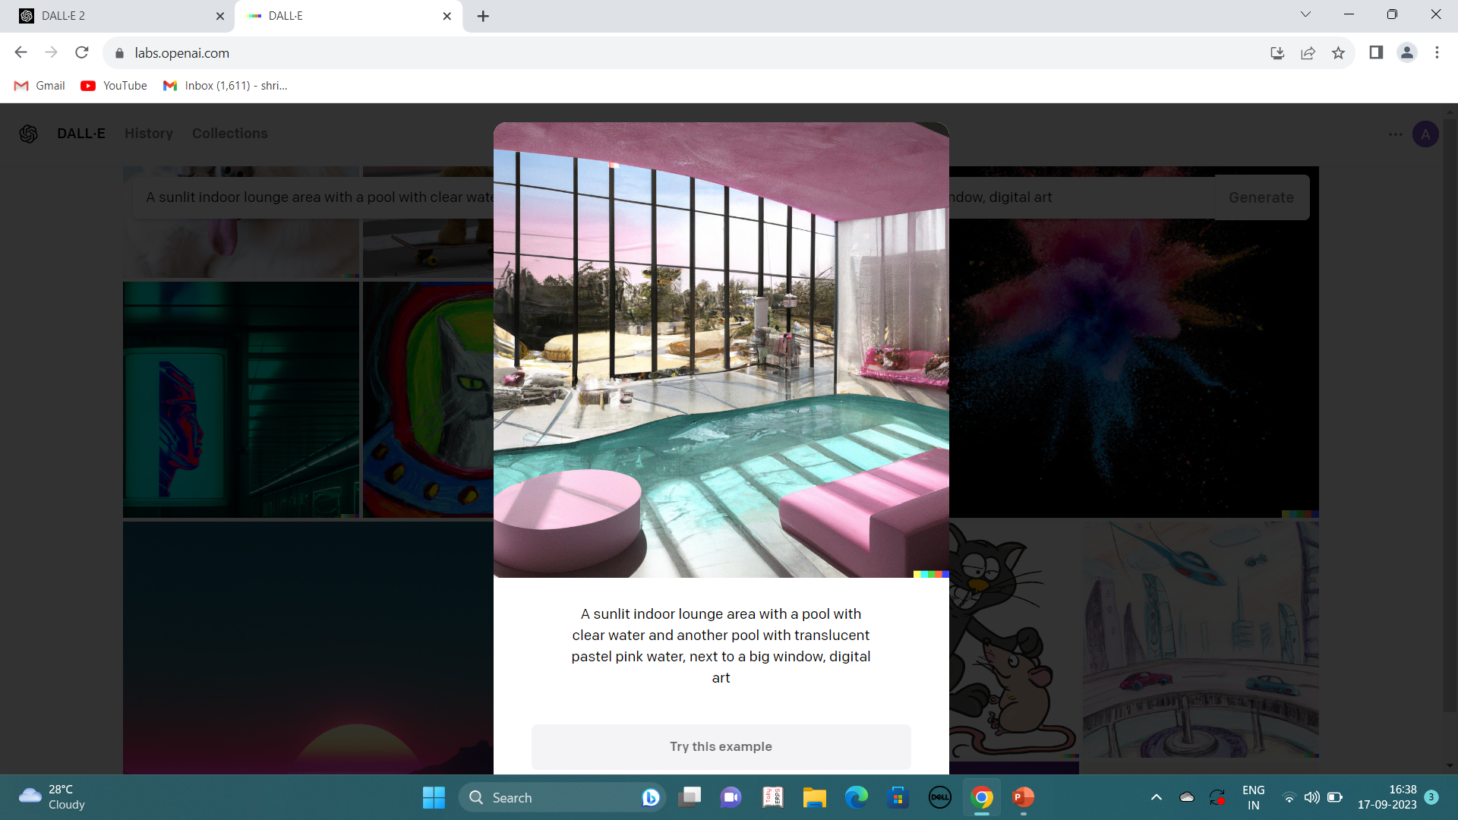
DALL-E2
OUTPUT
DALL-E (stylized as DALL·E) and DALL-E2 are text-to-image models developed by openai using deep learning methodologies to generate digital images from natural language descriptions, called "prompts".
INPUT
A sunlit indoor lounge with a pool with clear water and another pool with translucent pastel pink water, next to a big window, digital art.

Slide 7
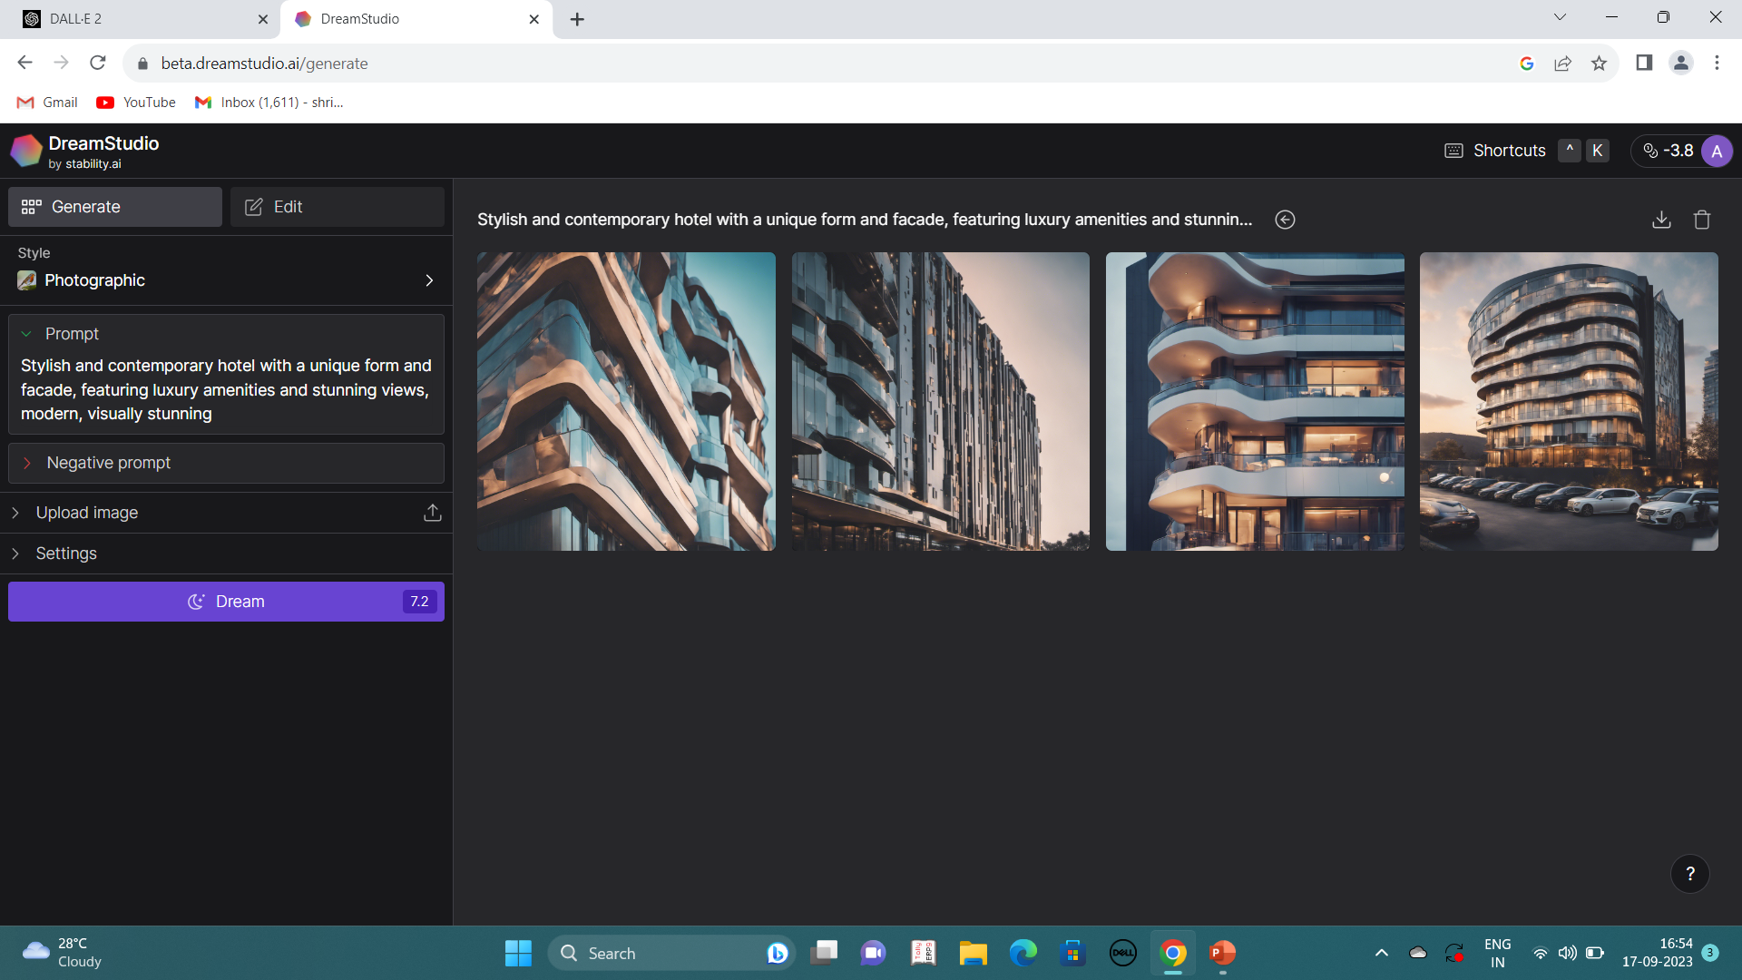
DREAMSTUDIO
DreamStudio is an easy-to-use interface for creating images using the latest version of the Stable Diffusion image generation model. Stable Diffusion is a fast, efficient model for creating images from text which understands the relationships between words and images.
OUTPUT
INPUT
Stylish and contemporary hotel with a unique form and façade, featuring luxury amenities and stunning views, modern, visually stunning.

Slide 8
ARTIFICIAL INTELLIGENCE CONTENT CREATION AND WRITNG TOOLS AND TEXT GENERATORS

Slide 9
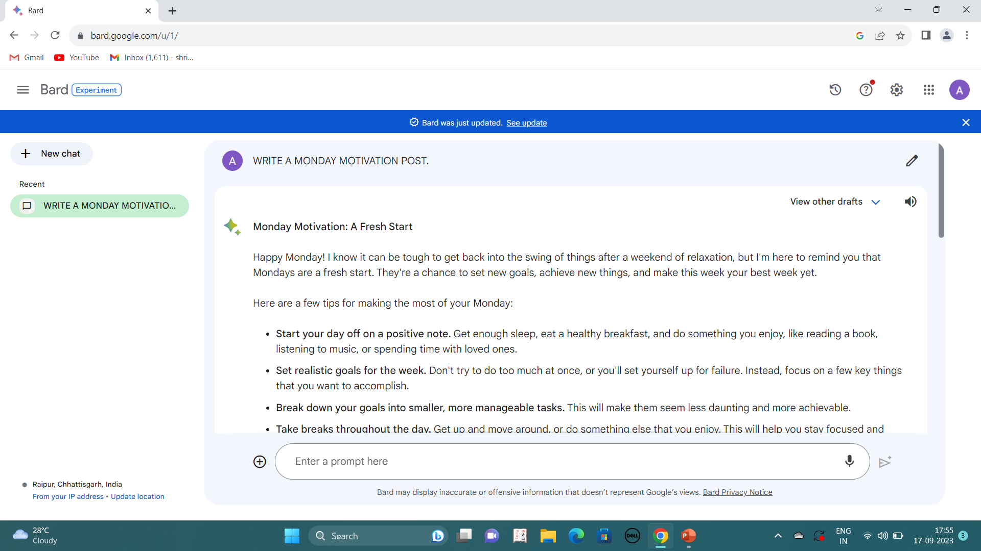
GOOGLE BARD
Google Bard is a large language model (LLM) chatbot developed by Google AI. Bard is trained on a massive dataset of text and code, and can generate text, translate languages, write different kinds of creative content, and answer your questions in an informative way.
OUTPUT
INPUT
Write a Monday motivation post.

Slide 10
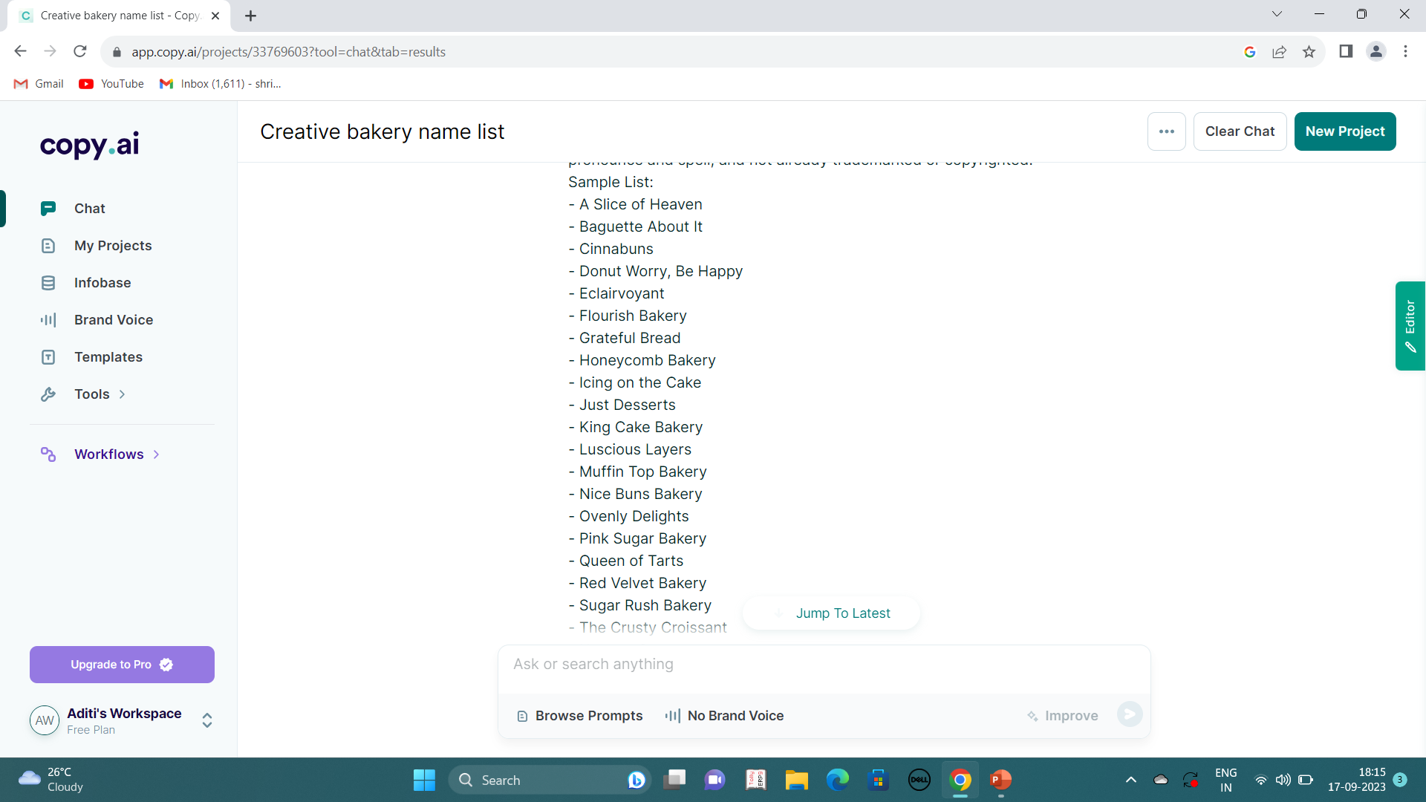
COPY.AI
OUTPUT
Copy.Ai is an ai powered copywriting platform that creates your best-performing customer-facing content. We help you write blogs, emails, sales copy, headlines and social media posts that convert.
INPUT
Give me a list of creative names for bakery shop.

Slide 11
ARTIFICIAL INTELLIGENCE MUSIC GENERATORS

Slide 12
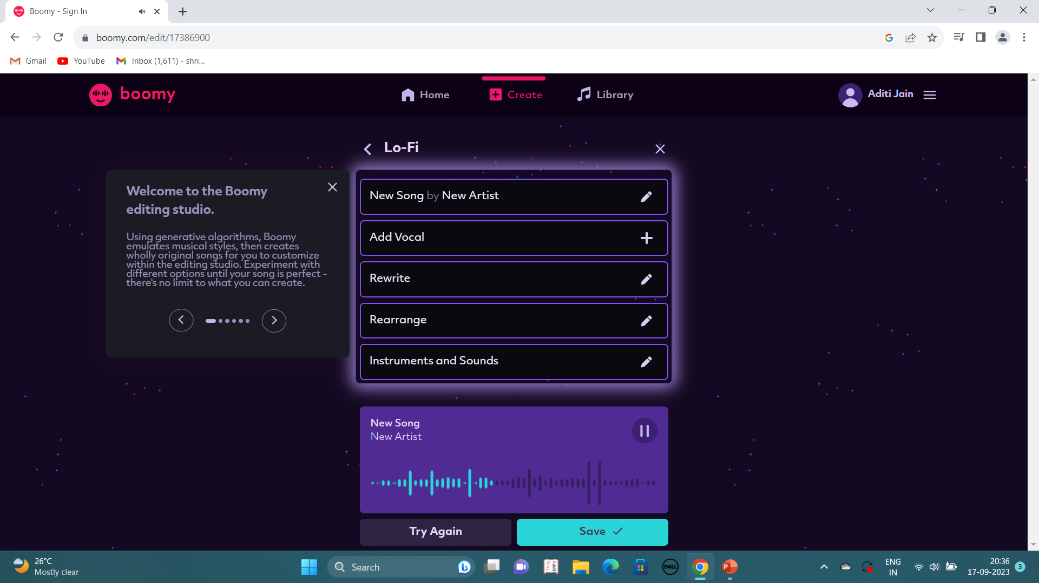
BOOMY
OUTPUT
Boomy uses artificial intelligence to help you personalize and create original music, even if you never created songs before. The more songs you create, the more boomy personalizes offerings based on your preferences.
INPUT
Customising own song.

Slide 13
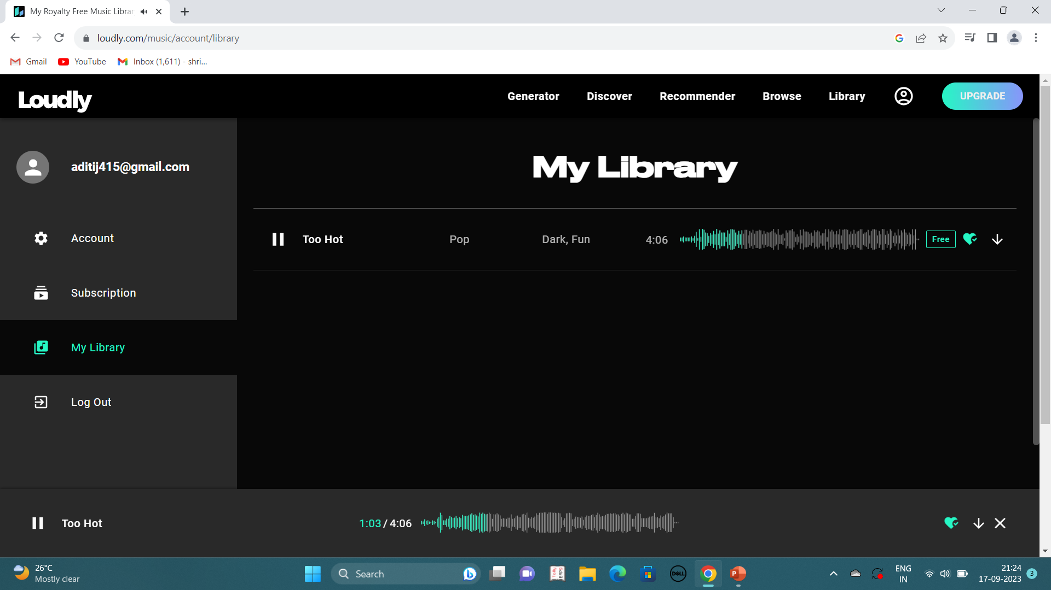
LOUDLY
OUTPUT
Loudly is an AI song maker which generates complex musical compositions with a multitude of song structures.
INPUT
Customising own song.

Slide 14
ARTIFICIAL INTELLIGENCE avatar generators AND FACE GENERATORS

Slide 15
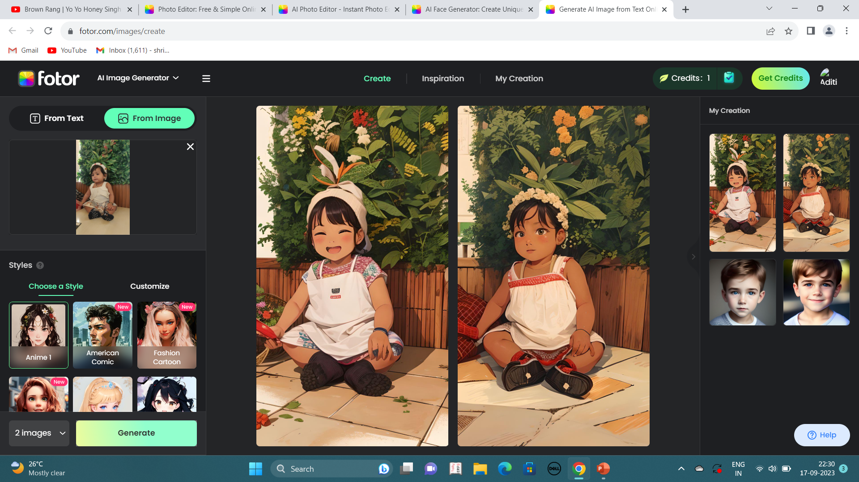
FOTOR
OUTPUT
Fotor is a powerful all-in-one ai photo editor app for everyone, including photo editing tools, design maker and photo collage maker.
INPUT
Customising image into anime.

Slide 16
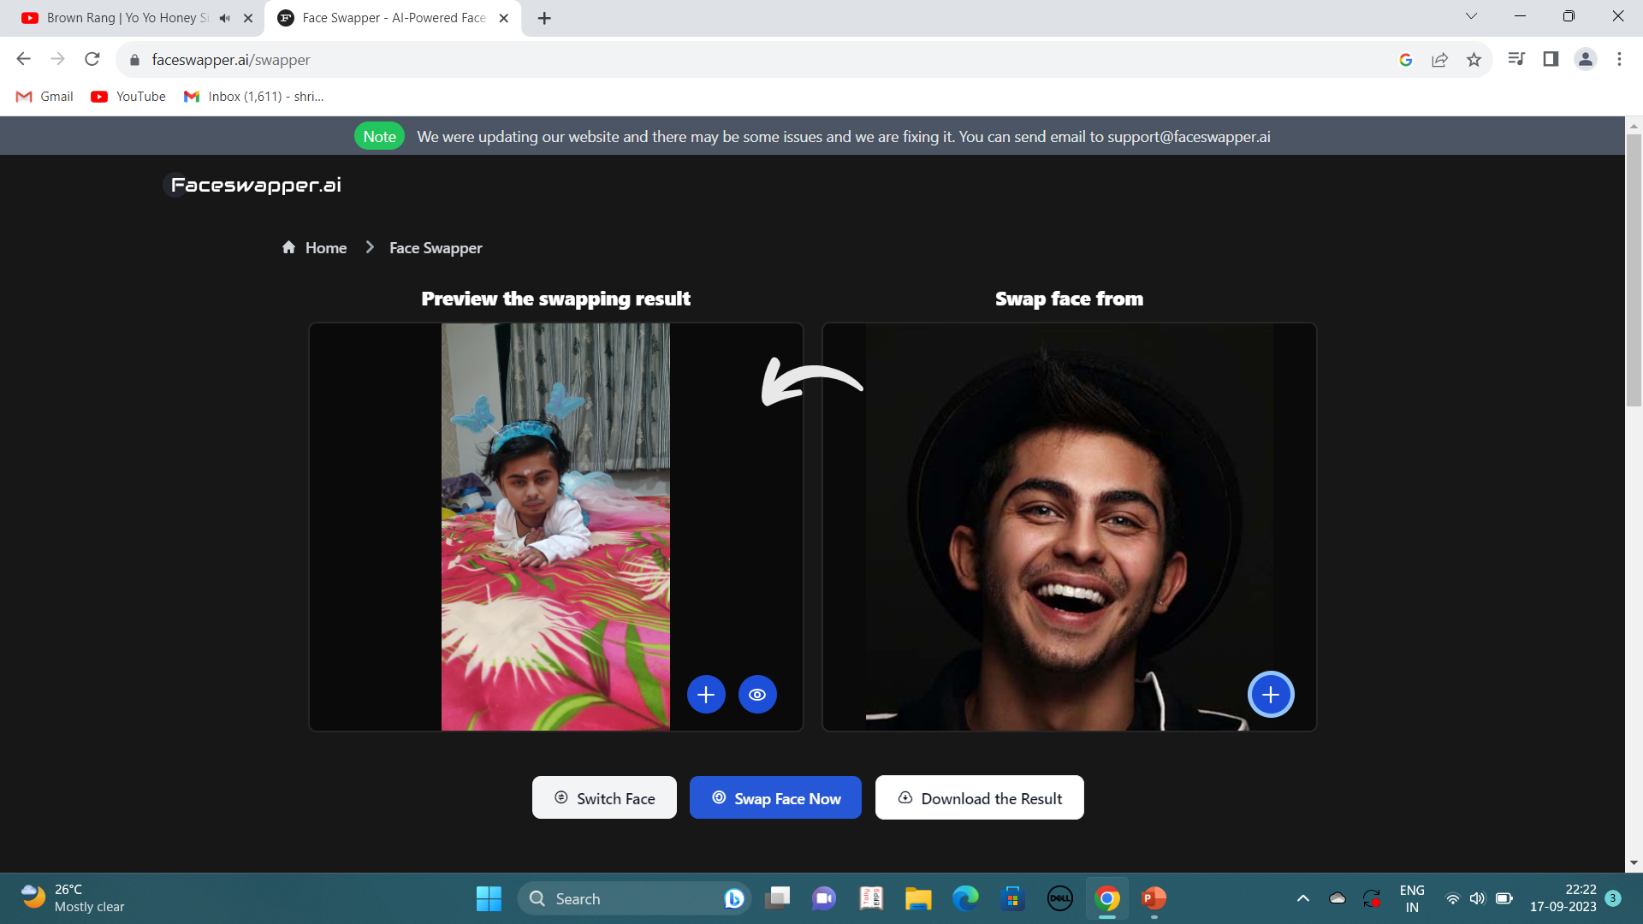
Face swapper
OUTPUT
Face Swapper is a tool that utilizes deep learning to recognize and swap faces in pictures and videos.
INPUT
Face swapping through image.

Slide 17
Artificial intelligence painting and drawing tools

Slide 18
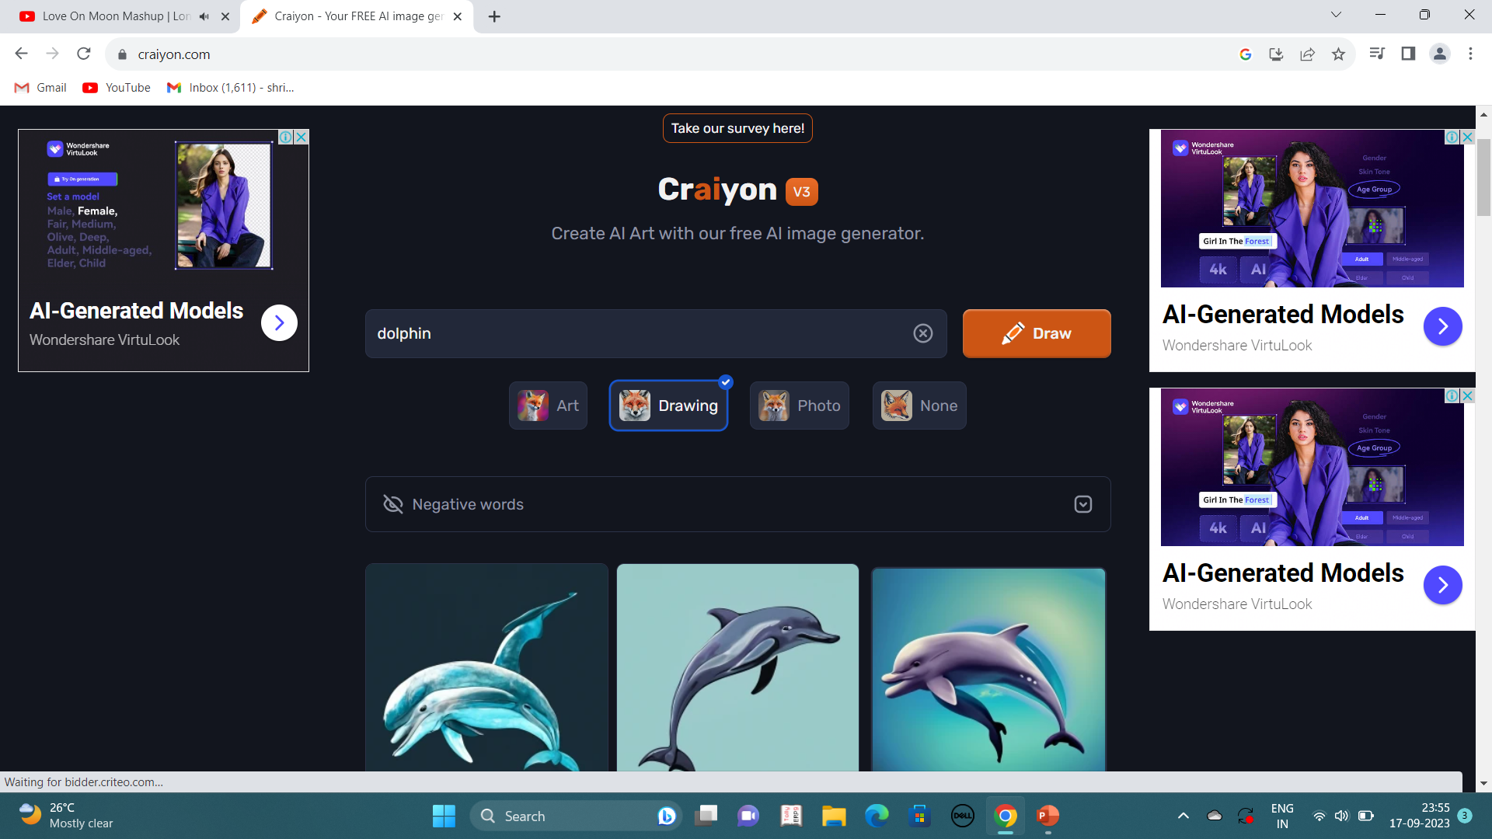
CRAIYON
OUTPUT
Craiyon is one of the first AI art generators that popped up in the market back in 2022. This tool uses DALL-E Mini technology behind the scenes to generate images from simple text inputs.
INPUT
Sketch of a dolphin.

Slide 19
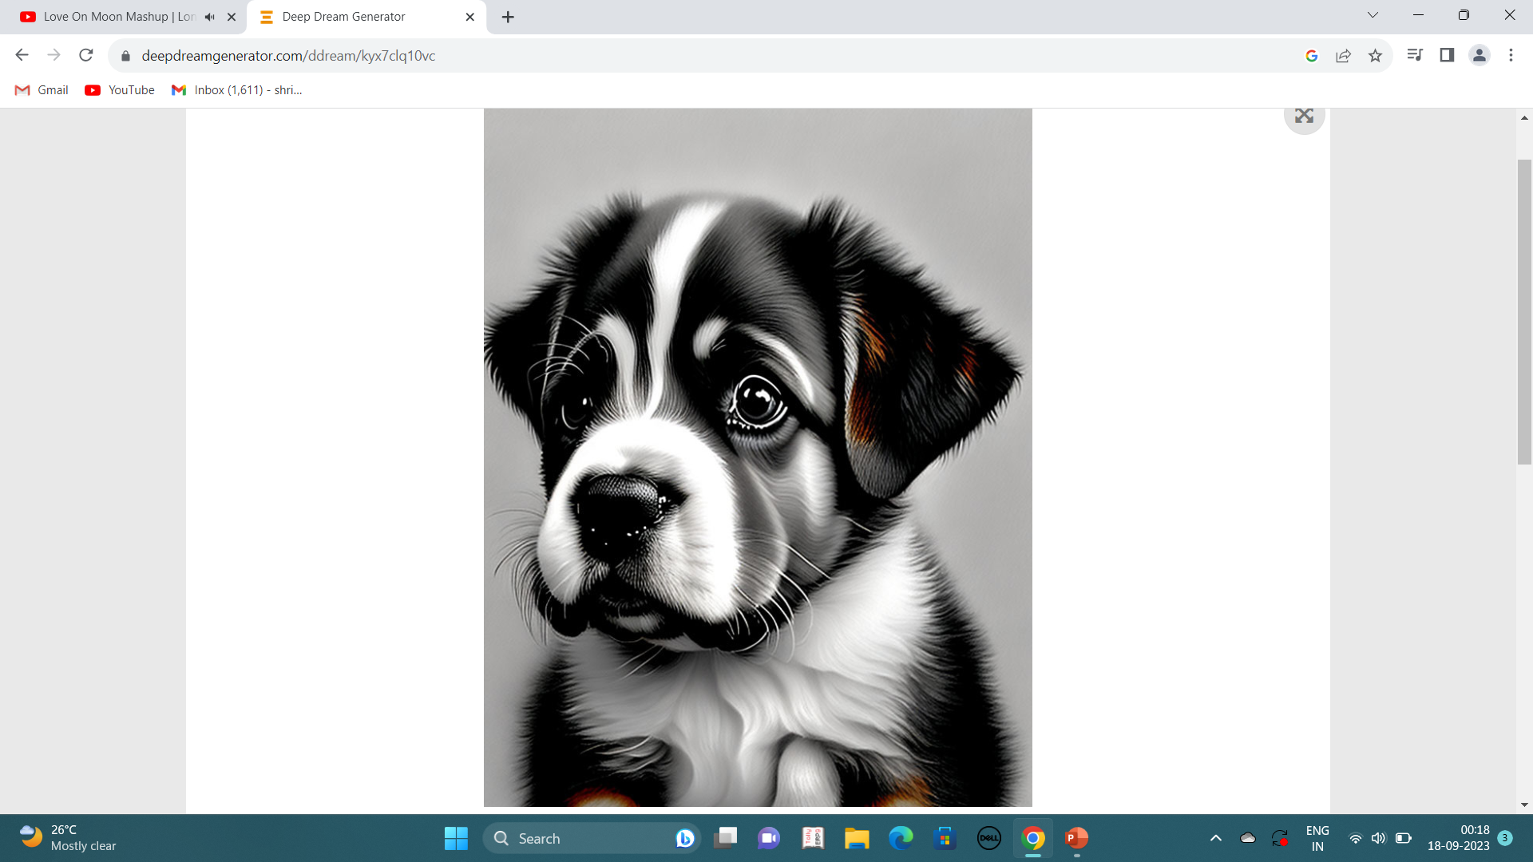
DEEPDREAM GENERATOR
Deep dream generator, an online platform that combines AI technology and art to bring your imagination to life. Our platform allows you to create amazing images and share them with a community of like-minded artists and explorers.
OUTPUT
INPUT
Pencil sketch of a cute little puppy.

Slide 20
ARTIFICIAL INTELLIGENCE AUDIO GENERATORS

Slide 21
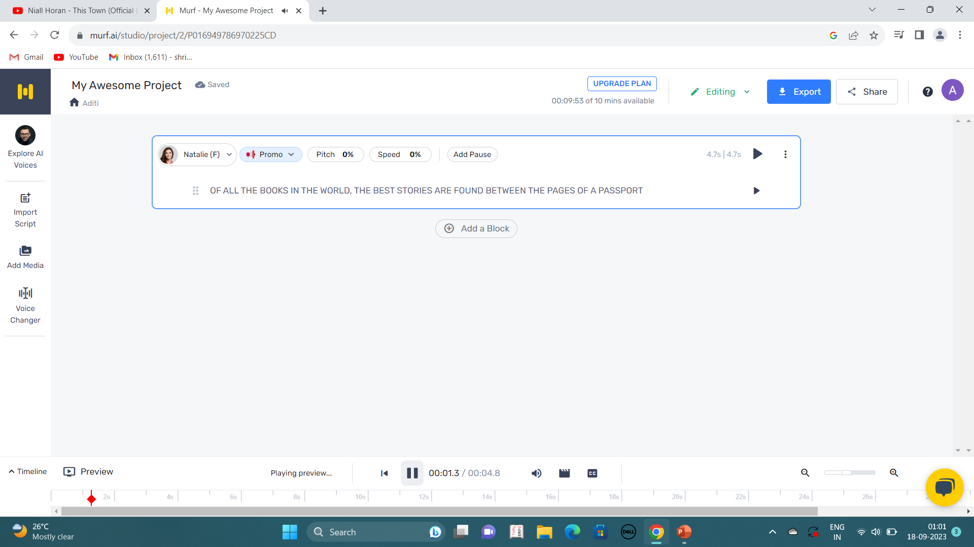
MURF
Murf studio is a cloud-based realistic text-to-speech platform that allows users to generate lifelike ai-based voiceovers for multiple use cases { e learning (authoring, LMS, etc.), You tube videos, podcasts, software & app demos, marketing & advertising, IVR phone system, audiobooks, games, product & explainer videos, corporate learning etc. Etc.}
OUTPUT
INPUT
Customising the text into voice.

Slide 22
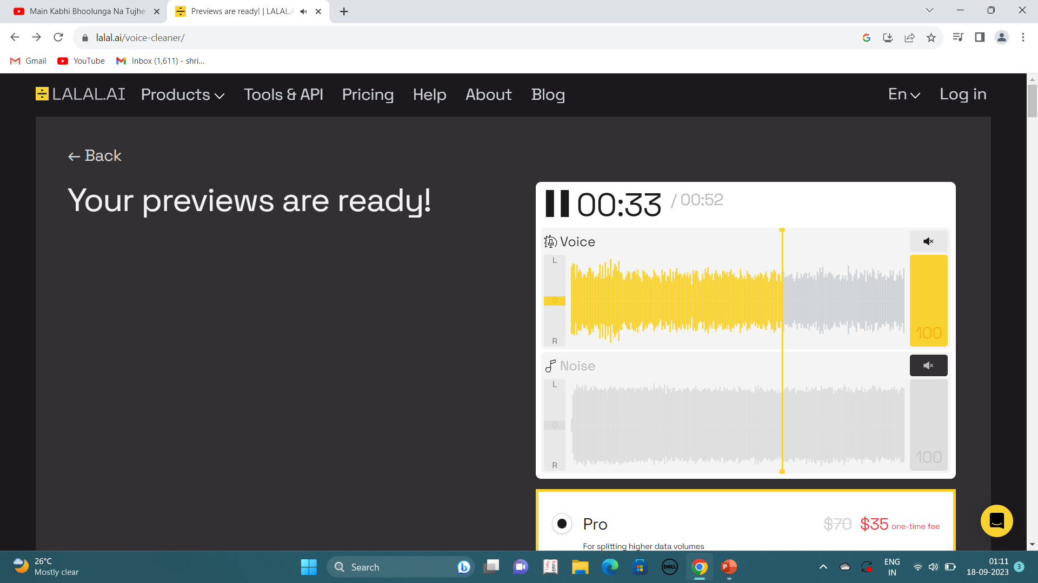
LALAL.AI
OUTPUT
The lalal.ai tool is an AI powered stem splitter and vocal remover that can extract vocals and instruments from audio and video files. It also includes a voice cleaner that can remove unwanted noise and artifacts from audio tracks.
INPUT
Unwanted noise removed from the video.

Slide 23
ARTIFICIAL INTELLIGENCE DESIGN TOOLS

Slide 24
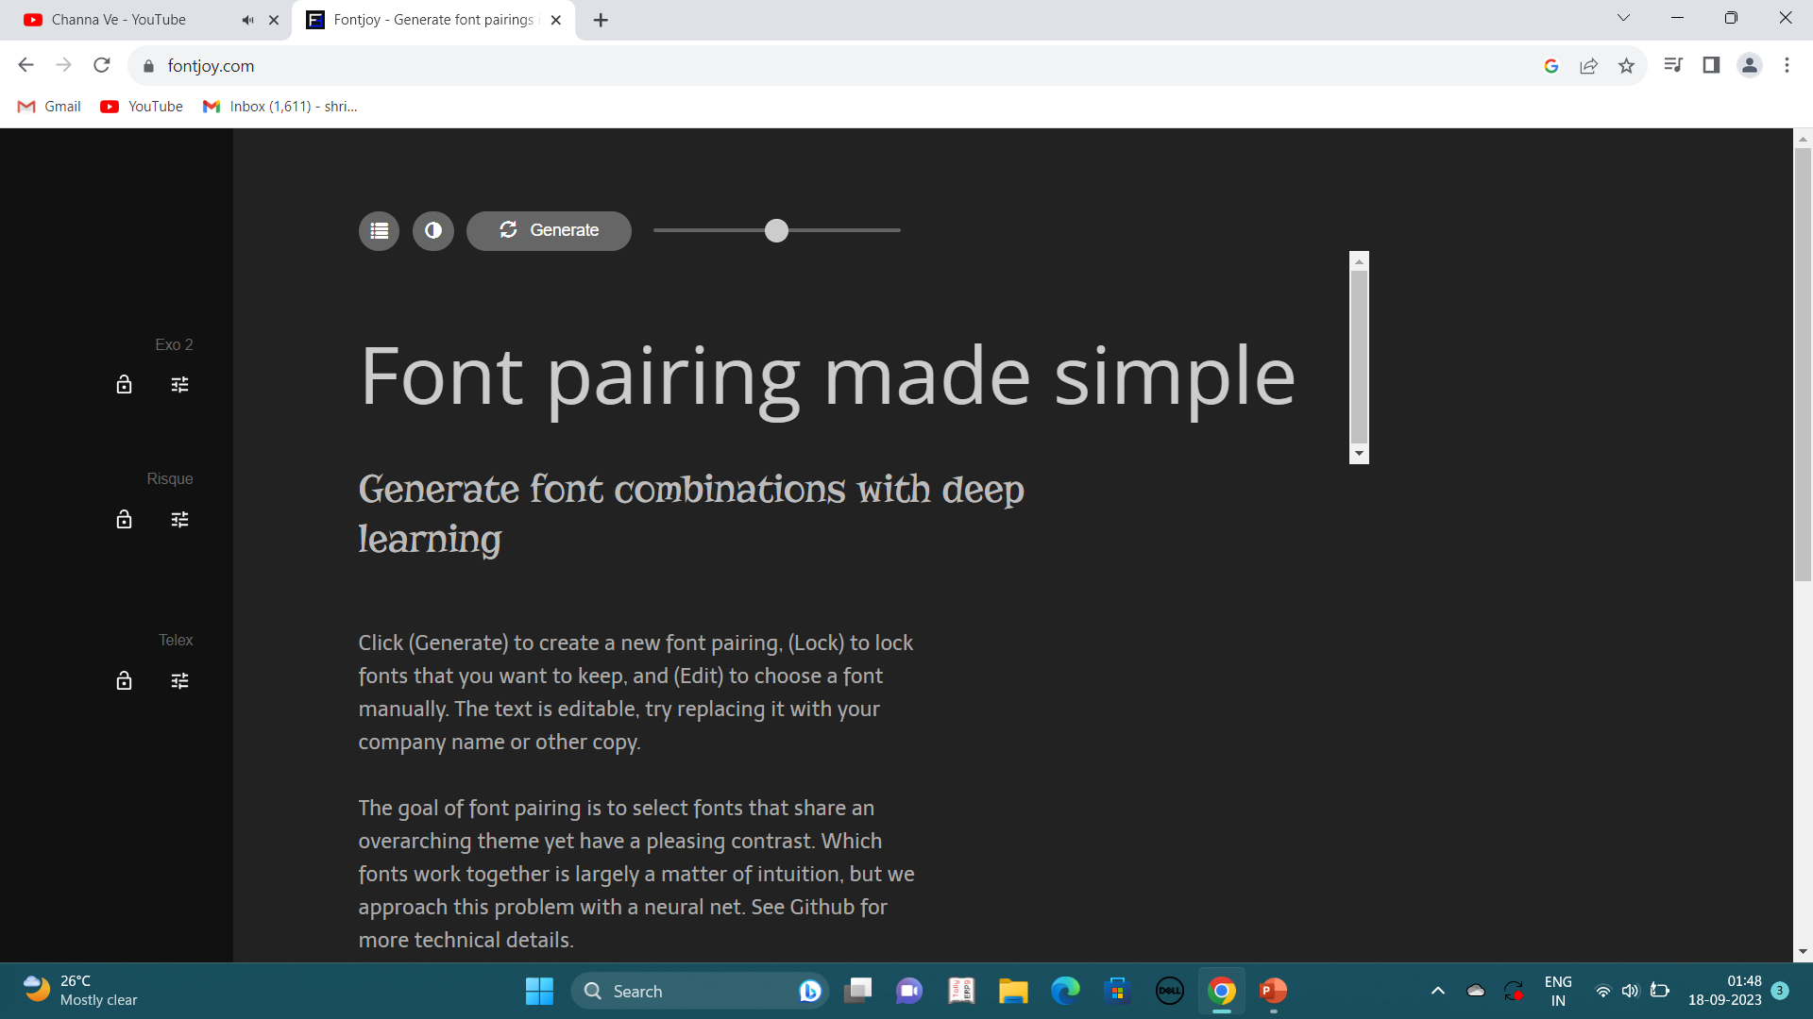
Font joy
output
Font Joy helps designers choose the best font combinations. Mix and match different fonts for the perfect pairing.
Input
Converting the font design to risqué font.

Slide 25
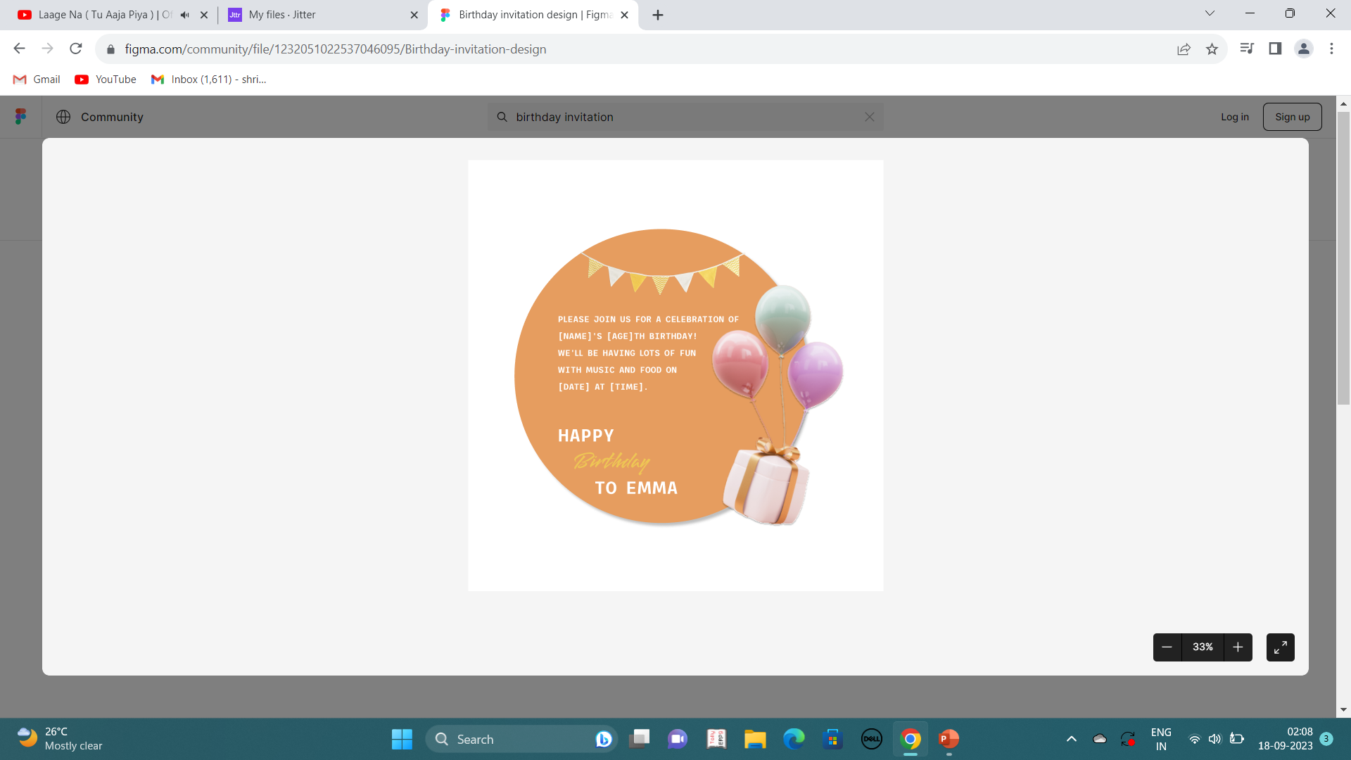
jitter
output
Jitter enables creators and teams to easily design stunning animated content and interfaces. Explore ideas faster with animation presets.
Input
Birthday invitation.

Slide 26
Artificial intelligence business tools

Slide 27
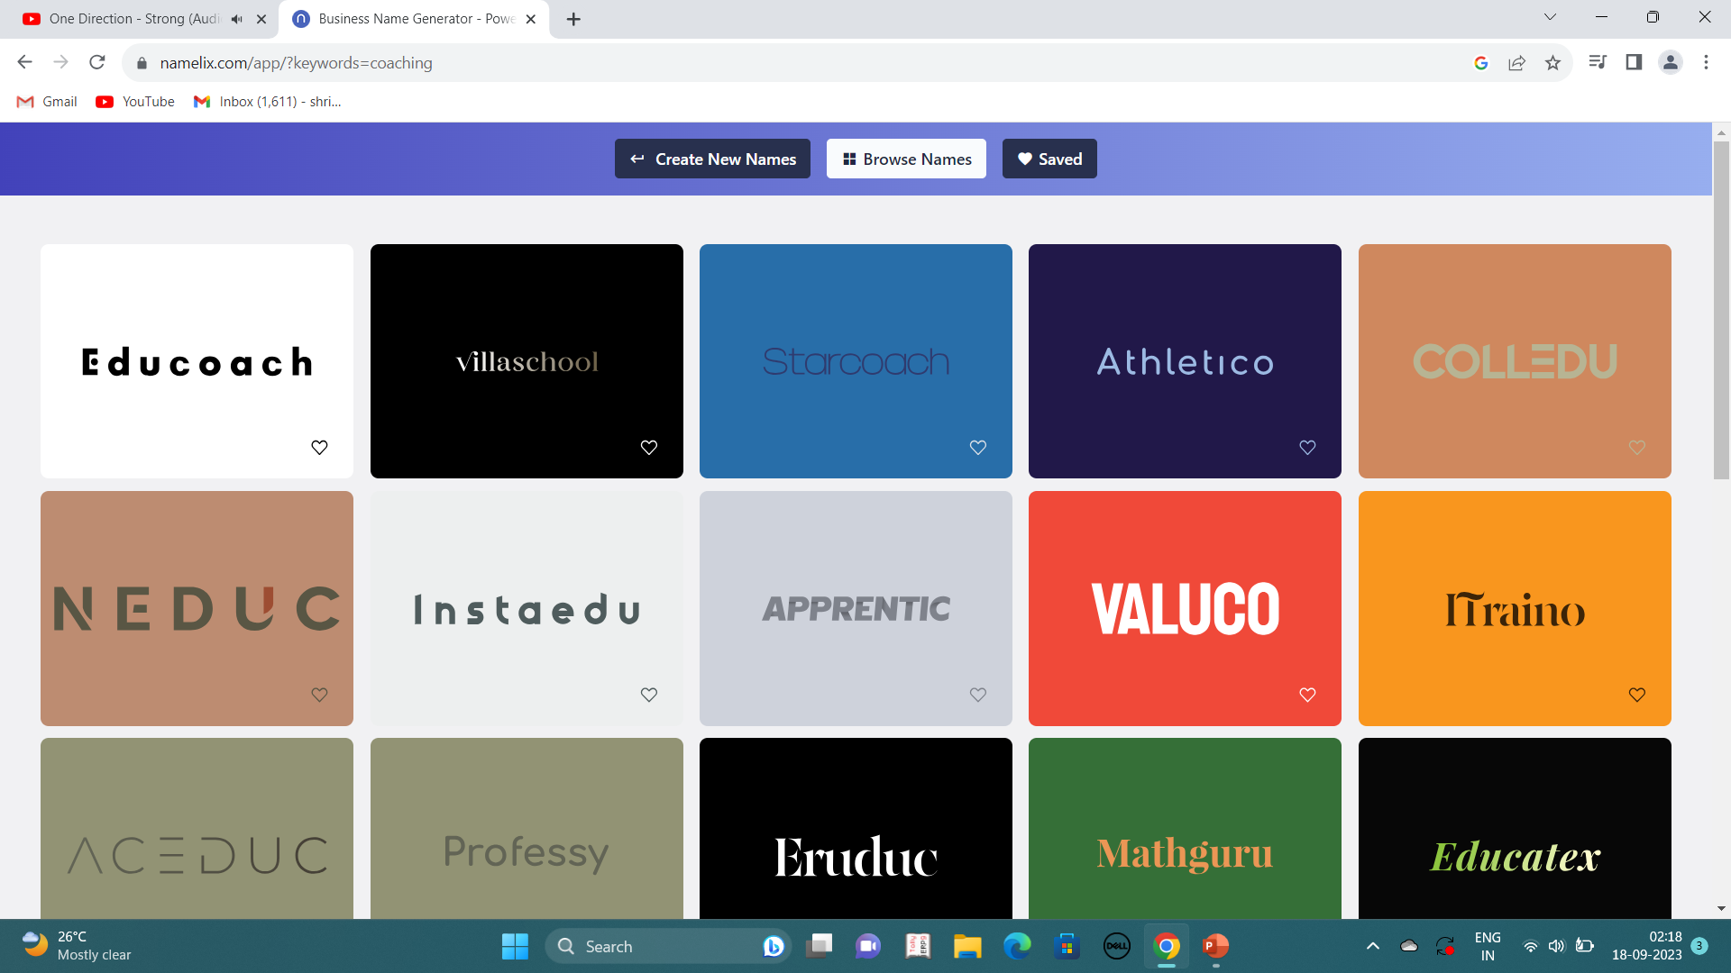
namelix
output
Namelix generates short, branded names that are relevant to your business idea.
Input
Coaching/education institution name.

Slide 28
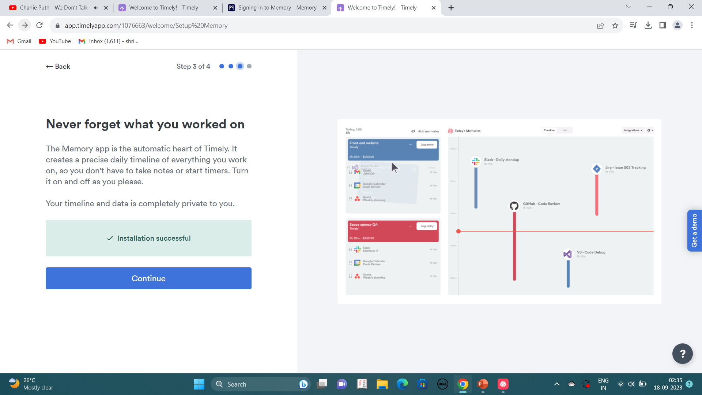
timely
output
Timely automates company time tracking, so you and your team can focus on the work that matters..
Input
Itraino institution tracking.

Slide 29
Artificial intelligence research tools

Slide 30
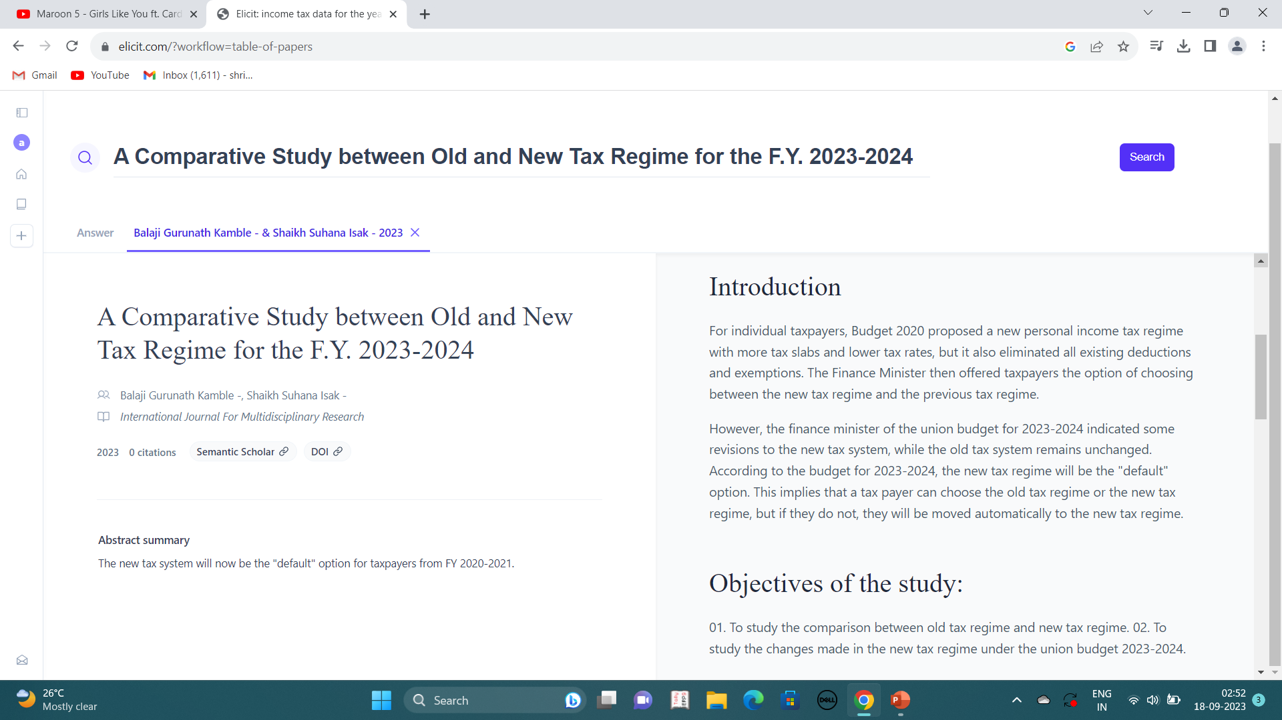
elicit
output
Elicit uses machine learning to help you with your research: find papers, extract key claims, summarize, brainstorm ideas, and more.
Input
Comparative study between old and new tax regime for the f.Y. 2023-2024.

Slide 31
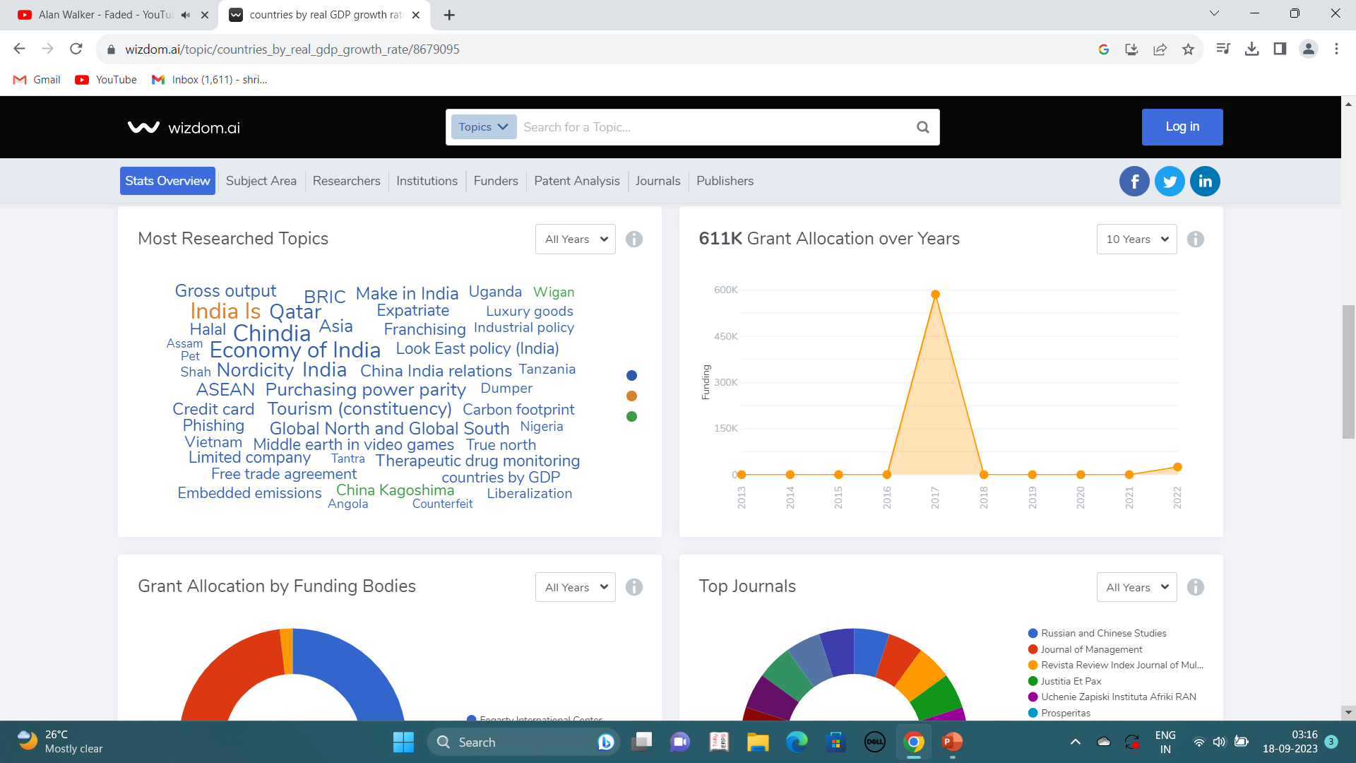
Wizdom.ai
OUTPUT
Wizdom.Ai combines data from a number of sources, and uses AI & machine learning to connect these disparate sources into a single, searchable graph.
Input
Most researched topics.

